Slide 1
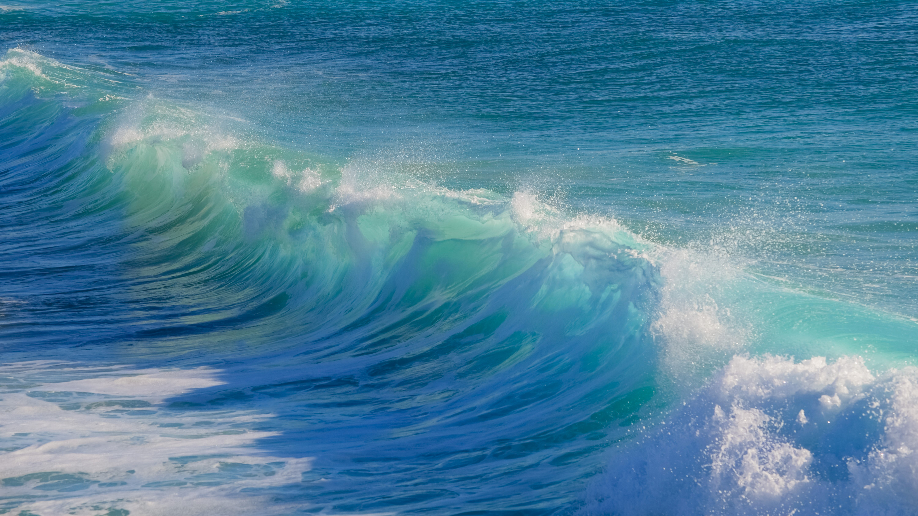
DS4440 Final Presentation
DEEP LEARNING
SURFER TRACKER
By Lubaina Malvi, Willem Shak, Yasmeen Dao, Yining Tao
Notes:
Hi everyone for our final project we decided to create a surfer tracker.

Slide 2

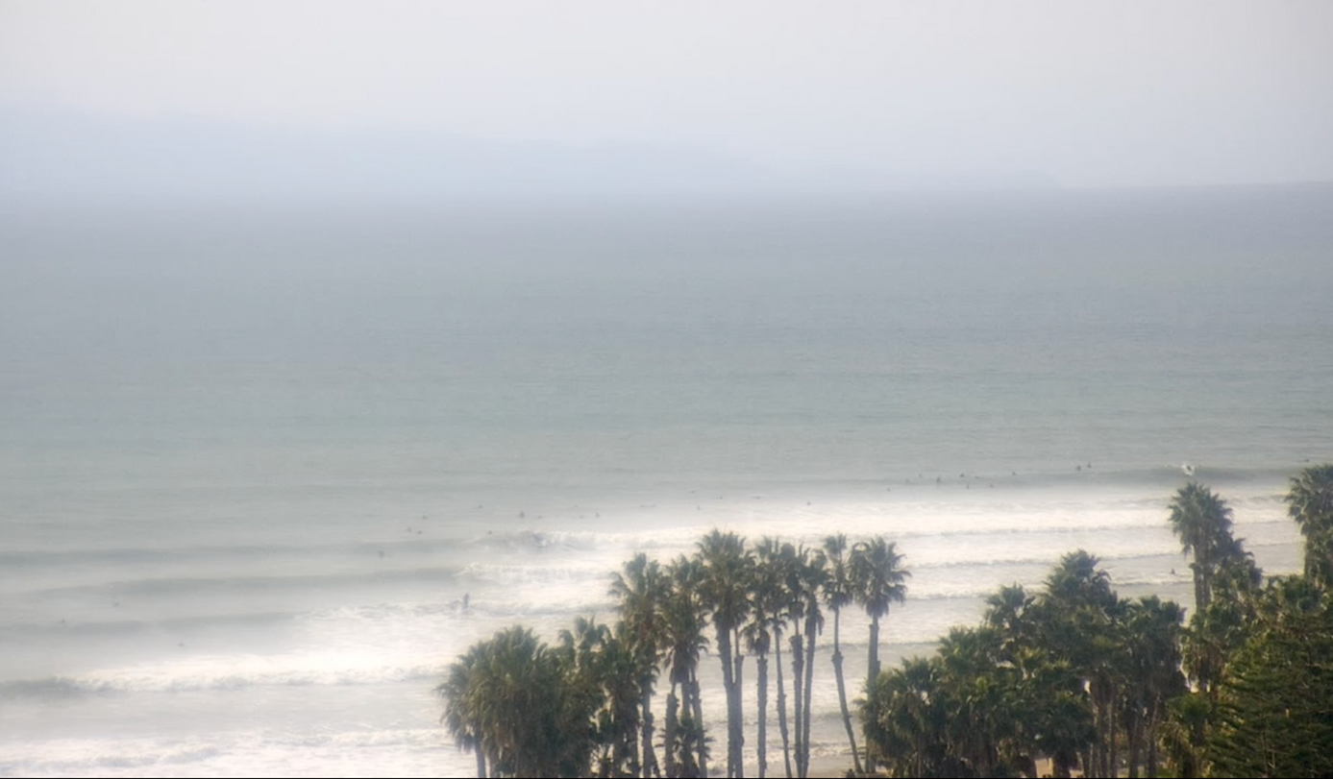
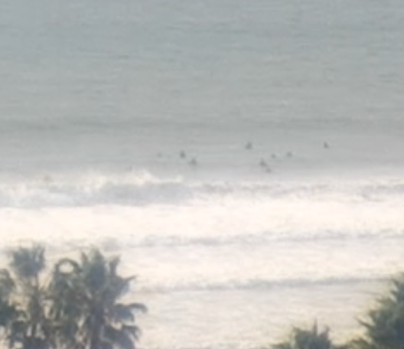
BACKGROUND
Tracking yourself from the beach cameras is HARD. You have to scrub through hours of video, and it’s really easy to lose yourself
I want videos of me surfing, I don’t want to do all the work to find myself
Our goal is to track surfers with unique IDs such that we can know where I am at all times during the recording
We also would like to know when a surfer is on a wave, so that it can automatically take a clip of it
Detecting relatively small objects (surfers) in complex, dynamic environments (waves, oceans)
If we can make an object detector on images, combined with a tracking algorithm, we can apply it to video
Notes:
A problem that almost everybody who surfs (like willem) faces is that when they surf, the only footage they can get of themselves most times is from a camera on the beach.
And this is an example of what that footage can look like. So scrubbing through hours of video and having to track where you are the whole time is a pain, especially when there are many other people in the water with you, it gets extremely easy to lose yourself. So we wanted to make a way to track surfers with unique IDs such that they can know where they are at all times. We also wanted to detect when a surfer is on a wave so we can automatically take a small video clip of it.
Our project is about detecting relatively small objects (surfers) in the water in dynamic environments like the ocean. And if we can make an object detector on images, combine it with a tracking algorithm, we can apply it to videos.

Slide 3

GENERAL OUTLINE
01
02
03
04
Dataset and Preprocessing
Custom Transformer Based Models
on the general detector dataset
Pre-trained Model
On both General detector and on wave detector
Limitations/Future Plans
Notes:
For our project we first found some datasets of images of surfers in the water at various distances from the camera and all of these images had different amounts of people in the water.
Then we attempted to try a custom transformer based model to identify each of the surfers using the general detector dataset. And then finally, we experimented with a pre-trained model on both general and on wave datasets.

Slide 4
DATASETS (YOLO FORMAT)
OnWave detection
Combined two datasets of closeup images of surfers from Roboflow
267 images with labels of Breaking wave, Non-breaking wave, Pocket, Surfer, Surfer-riding, and wave
855 images with labels surf, and surfer
Cleaned labels to be only class 0 if there is a surfer
1
General Detection
30k images from Roboflow with label surfer (0-27 surfers)
19k of the images had no surfers (no label)
These images were 224x224, and from very far away, the surfers were very small in the image
2
Notes:
We used three datasets for this problem. The first two datasets we combined and used for OnWave detection - detecting when a surfer is on a wave. These had closeup images of surfers. The first of the two datasets has 267 images with labels breaking wave, non breaking wave, pocket, surfer, surfer riding, and wave. The second of those two datasets has 855 images with labels surf and surfer.
To combine these, we cleaned the labels to be only class 0 is there is a surfer.
The third dataset we used was for generally detecting surfers in the water. This dataset has 30 thousand images with the label surfer and the images had between 0 and 27 surfers.
19 thousand of the images had no surfers
and these images were 224 by 224 and from very far away.

Slide 5
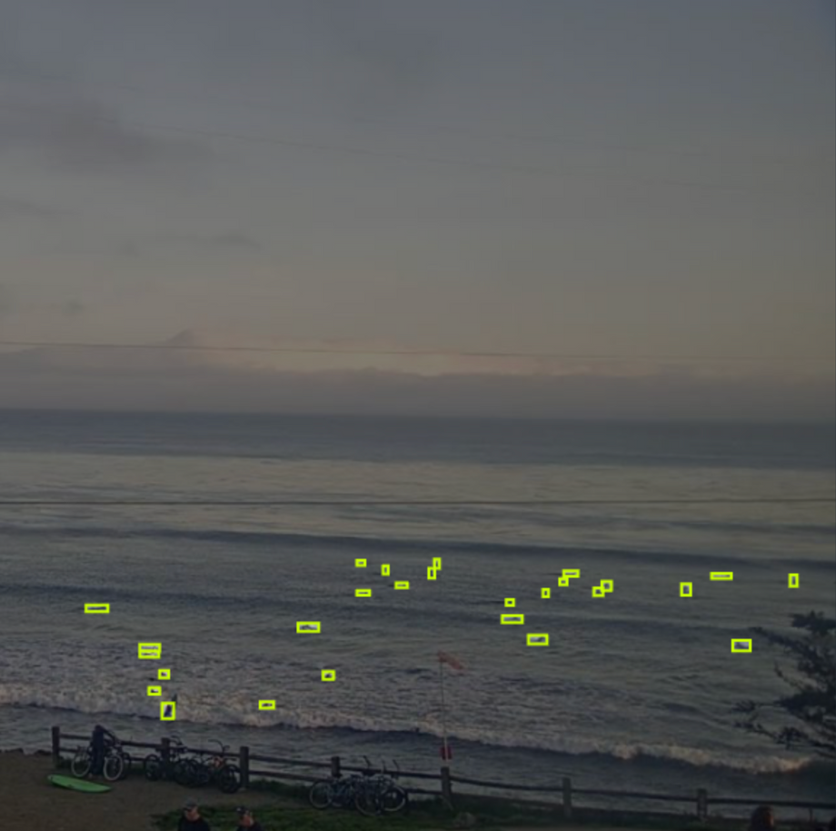
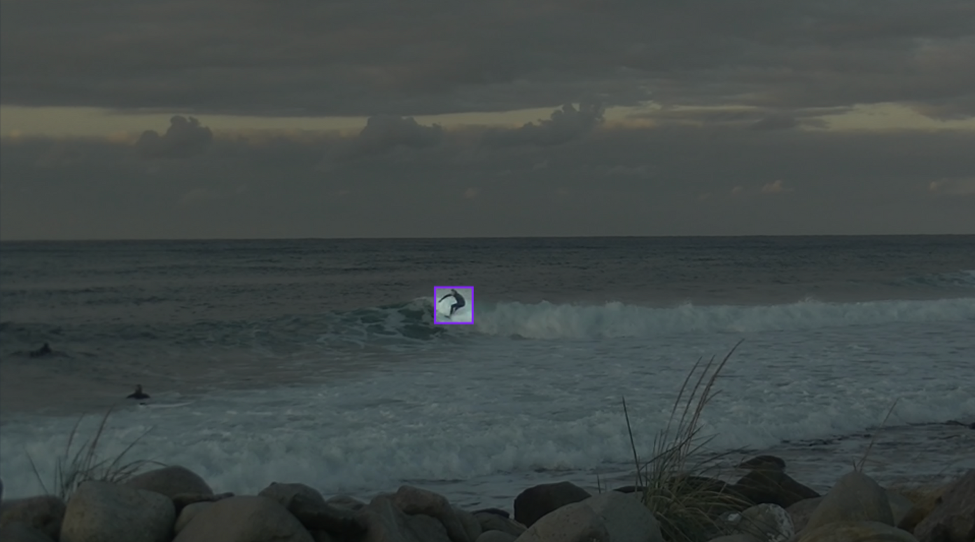
SAMPLES FROM EACH DATASET
General Detector
On-wave Detector
Notes:
Here are samples from each of the datasets. As you can see on the left, the general detector has many surfers who all basically look like small dots in the water.
On the right is a sample from the On wave detector and the surfer is much more clearly visible.

Slide 6
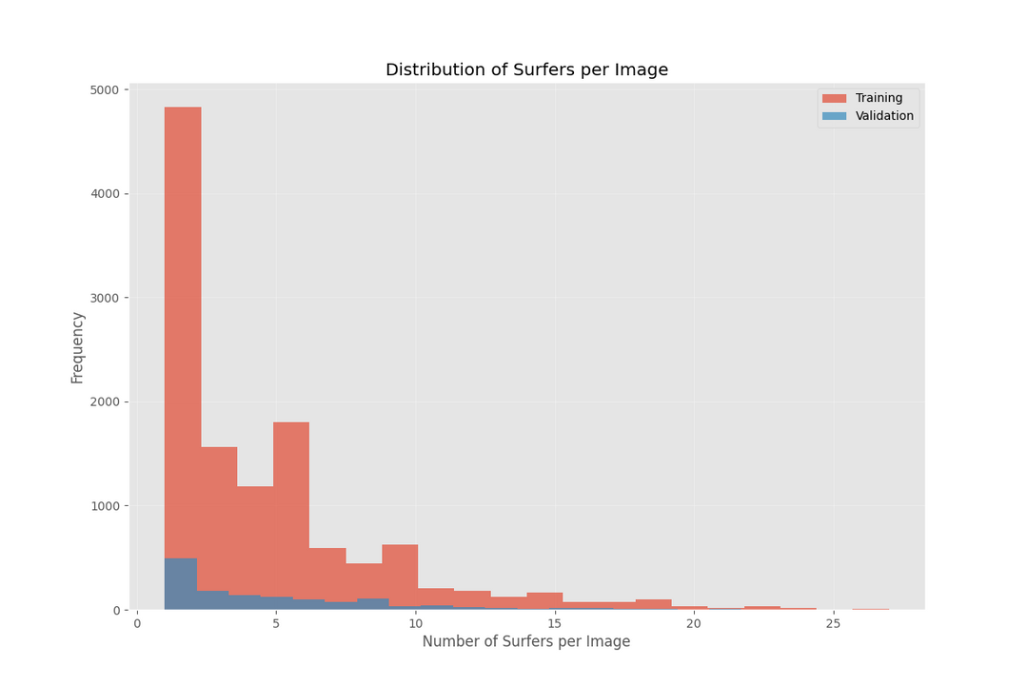
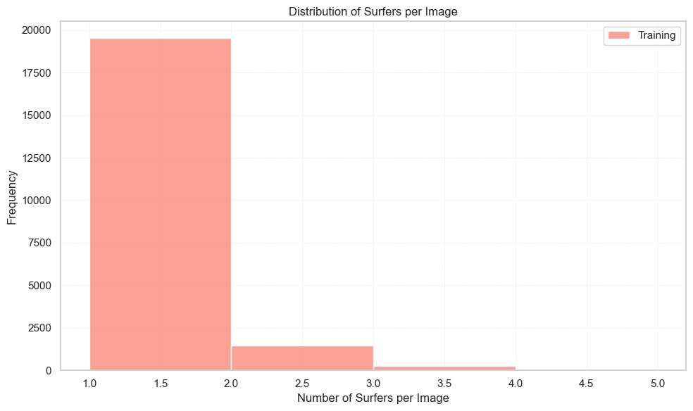
EDA
General Detector
On-wave Detector
Notes:
We did some EDA on the datasets to see what we were working with.
For the general detector, the majority of the images had between 0 and 10 surfers but there were also images with many more.
For the on wave datasets, most of the training videos has only 1 surfer and a smaller number of images contain 2 to 5 surfers.
which tells us that this dataset is mostly made for detecting individual surfers not crowds.

Slide 7
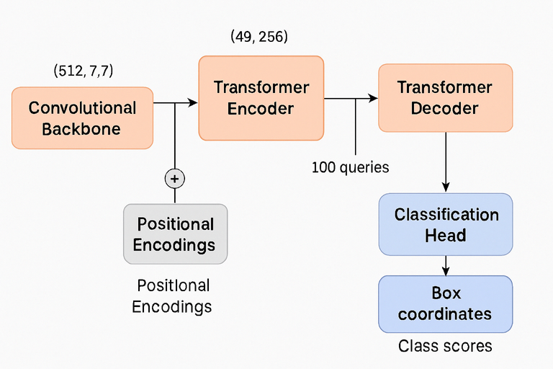
CUSTOM MODEL V1 (GENERAL DETECTION)
Architecture
Input Image: 224x224 RGB image (3, 224, 224)
Custom CNN backbone: 64 → 128 → 256 → 512 channels
Feature Extraction to shape (512, 7, 7)
We flatten to (49, 512) then apply 1x1 convolution to (49, 256)
Positional Encoding: Sinusoidal positional embeddings added to the 49 feature tokens
Transformer: 3-layer encoder-decoder with 8 self-attention heads
Encoder processes 49 tokens, gives global context
Decoder takes in encoded image and 100 learnable query embeddings,
shape (100, 256)
Queries: 100 learnable objects for box prediction (100, 256)
Each query represents a potential object in the image
Detection Heads: Classification and Box Regression (MLPs)
Classification head is a linear layer that maps from 256 → 2 classes (background or surfer)
Box regression head is a 3 layer MLP (256 → 256 → 256 → 4)
Output format: (cx, cy, w, h) — all normalized between [0, 1]
Hungarian Matching: Matches the 100 predictions to ground truth boxes (one to one)
Loss: Classification loss, Box Regression loss, GIoU loss added together with different weights
Classification - performs cross entropy loss on the matched pairs
Box regression - L1 loss between matched pairs
Generalized Intersection over union - Encourages boxes to better overlap
Notes:
So for our first custom model, we wanted to do the task of general detection.We took in the input images, fed it into 4 convolutional layers that extracted features, used sinusoidal positional embeddings and fed that into a transformer where it encodes the features from the convolutions, then that and 100 learnable queries are fed into the decoder which creates the queries which can be used for prediction. Each query is fed into the two detection heads, a classification head which is just a linear layer that maps to the two classes of background or surfer, and the box regression head that is an MLP to find the 4 box values of x and y position, width and height.
To find the loss, we use hungarian matching to match the predictions to ground truth boxes, where there is only one match per ground truth label. THen we take the loss of those matches with classification loss which is like binary cross entropy, box regression loss which is the L1 loss, and the generalized intersection over union.

Slide 8
CUSTOM MODEL V1 RESULTS
The model was able to generally find the area of the surfers, but not localize the box well
Was able to reliably predict no surfer when there were no surfers
Confidence levels were in the 0.9's for surfers, but was overpredicting
Training loss decreased from 3.28 to 3.04
Validation loss: ~0.73-0.83
Precision/Recall/F1: 0.0 consistently
Mean IoU: 0.0 consistently
Box loss component: 0.0 consistently
Average detections: 3.5-6.27(ground truth: 2.43)
Notes:
The model was able to generally find the area of surfers, but not well. It was also able to reliabily predict no surfer when there were no surfers. Confidence levels were really high for the surfers but it was over predicting. The Loss only decreased a little, but what's interseting is that the metrics like Precision, mean Intersection over union, and box loss were always 0, because it never learned to fit the ground truth boxes tightly enough to trigger the IoU threshold and create a false positive or something like that.

Slide 9
CUSTOM MODEL V1 TUNING
To encourage the boxes to localize better, we can turn up the weights for box regression loss and GIoU loss
After playing with all these loss weights for a couple of days, there was no improvement
One epoch takes an hour, very hard to iterate on
Too much information was lost during the convolutional layers
LOSS = 2.0 * LOSS_CLASS + 2.0 * LOSS_BOXES + 1.0 * LOSS_GIOU
LOSS = 2.0 * LOSS_CLASS + 20.0 * LOSS_BOXES + 10.0 * LOSS_GIOU
Notes:
Something we played around a lot with was the loss function, namely turning up the weights for certain behaviors we wanted to encourage like box regression and GIoU loss. We also experimented with focal loss instead of cross entropy for the classification loss, but since it takes so long to train, over an hour each epoch, it was hard to see good results. We also think that was just a limitation of our architecture, where we lost too much information during the initial convolutional backbone

Slide 10
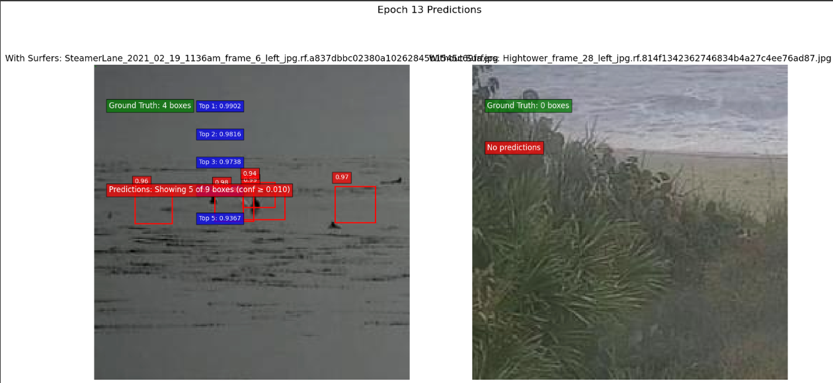
CUSTOM MODEL V1 RESULTS
Notes:
These are the final results after 13 epochs. We can see that the boxes are on the general y plane of the surfers, but wasn't good at separating the boxes or tightly fitting the surfers.

Slide 11
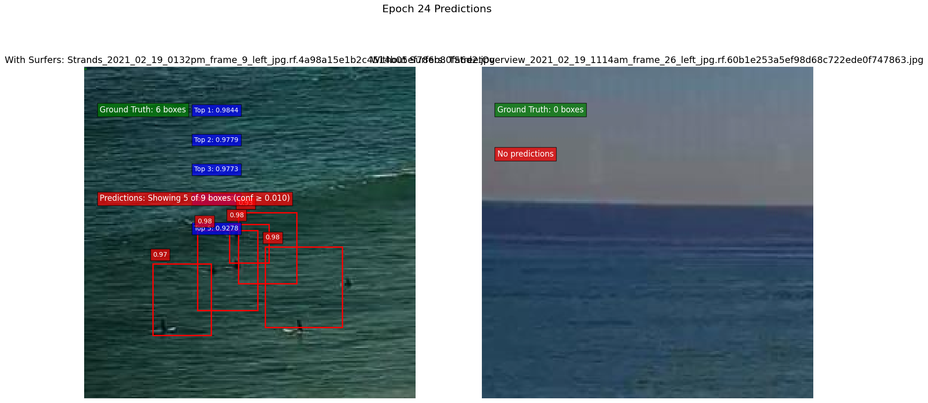
CUSTOM MODEL V2 CHANGES
Used Resnet50 backbone instead of Convolutional layers to retain more quality information
Loss weights: 2.0 * class_loss + 10.0 * box_loss + 2.0 * giou_loss
Trained for 10 epcohs
Notes:
Since that wasn't going well, we wanted to change our architecture. We used a pretrained Resnet50 instead of convolutional layers to retain more information, and with the same loss function, we were able to get simlilar results to the previous version after about 10 epochs.

Slide 12
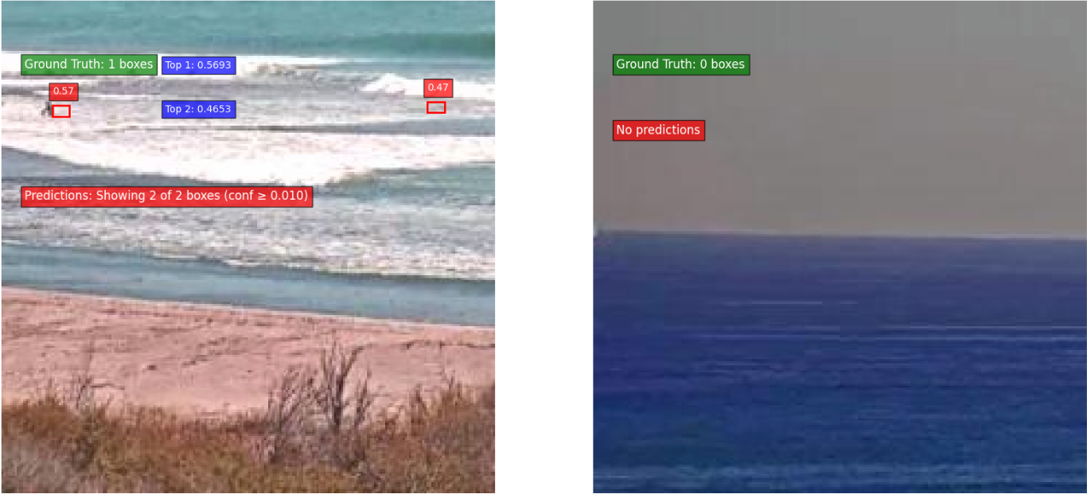
CUSTOM MODEL V2 CHANGES
Adjusted loss weights: 2.0 * class_loss + 10.0 * box_loss + 10.0 * giou_loss
Trained for 10 more epochs
Notes:
We then adjusted the weights to increase the GIoU loss to 10 and trained for 10 more epochs. Now we were able to see much better localization, and it finally seemed like itwas getting somewhere.

Slide 13
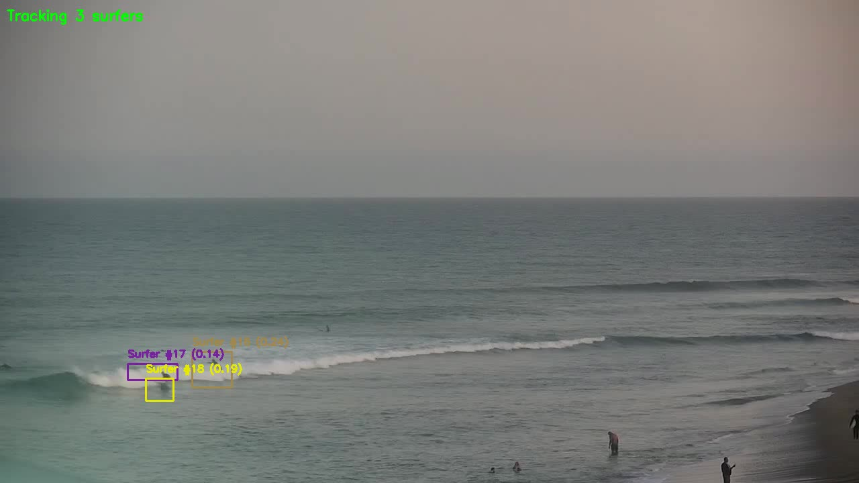
CUSTOM MODEL V2 WITH SORT
Notes:
At least we thought it would do well. Here we combined it with our tracking algorithm SORT, and it was not very precise or reliable, but there was some resemblance of tracking.

Slide 14

PRE -TRAINED
YOLOV5
Simpler to start out with
Particularly good to use for detecting surfers because of the ability to handle various orientations and object scales
YOLOv5 model is single-shot object detection and uses CNNs to process image in single pass
Notes:
Numerous augmentation techniques to try and fine tuning abilities.

Slide 15
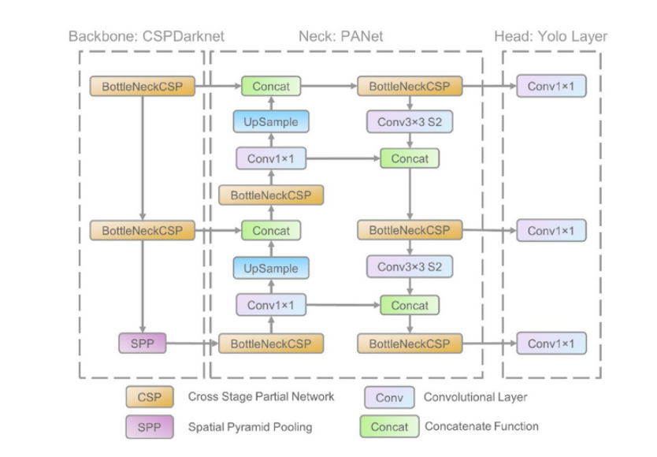
YOLOV5 ARCHITECTURE
Backbone: Main body of the network using CNN structure specifically CSPDarknet53
01
Neck: Spatial pyramid pooling fast (extract features from images)and path aggregation network structures (combine features from different layers)used
02
Head: generates the output
03
Notes:
High level overview
Input: images
Then there are 3 main components.
Backbone: pre-trained classification models, extracts features from input image
Neck: up-sampling to different state feature maps. Easier to detect objects of different sizes.
Head: Predictions to classes and bounding boxes of detected objects.
https://docs.ultralytics.com/yolov5/tutorials/architecture_description/

Slide 16
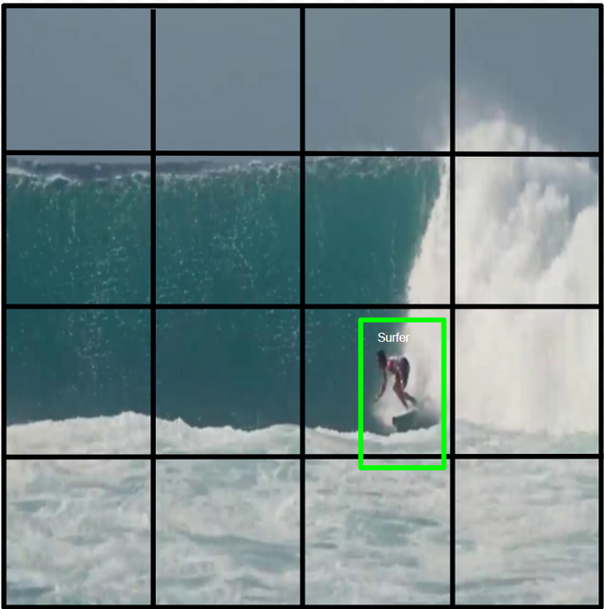
HOW IT WORKS
1. input image
2. divide the image into grid cells in “grid cell” system
3. for each cell predict bounding box (x,y,width, height), confidence score, class probabilities; if object exists and if what is there
4. filter results by keeping boxes with high confidence and apply non-max suppression to remove duplicates, where one object = one box
5. output with bounding box and confidence score or class name
Notes:
Steps from slide. YOLOv5 is essentially a single shot detector: Analogy instead of using a magnifying glass to scan a photo section by section, YOLOV5 can look at the whole image and see everything. Helpful for real time video.

Slide 17


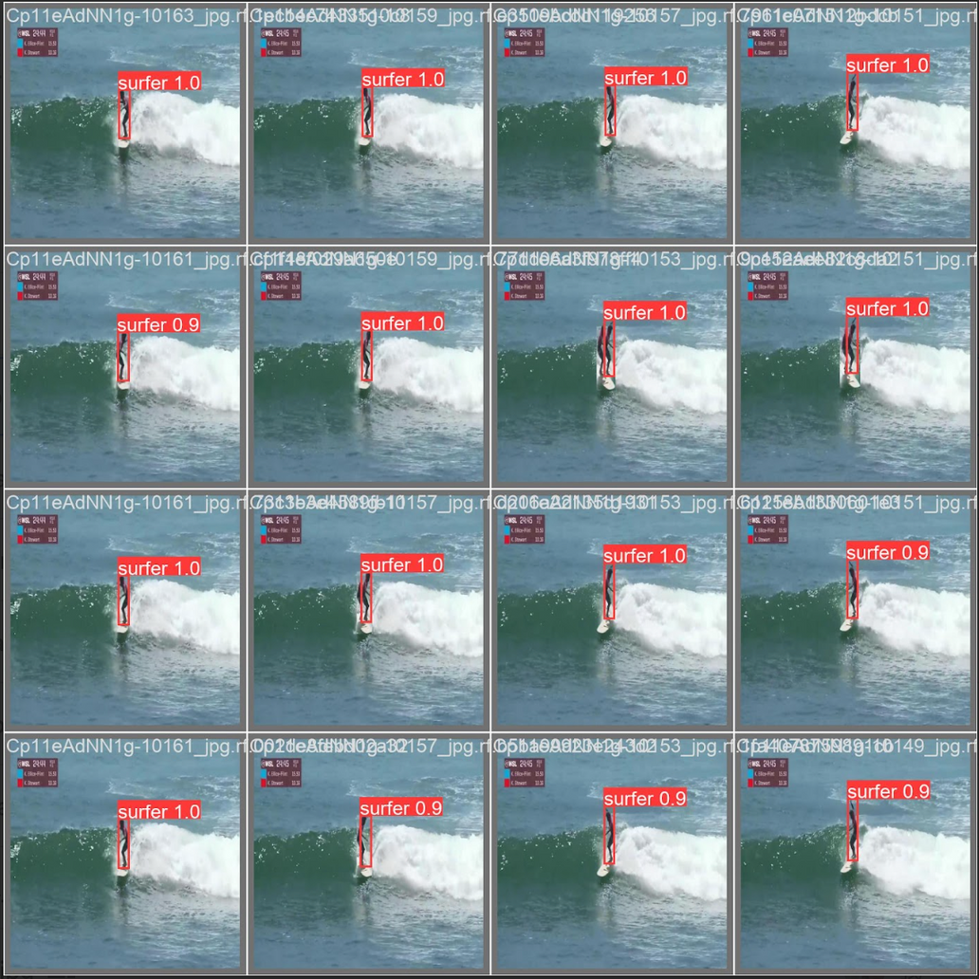
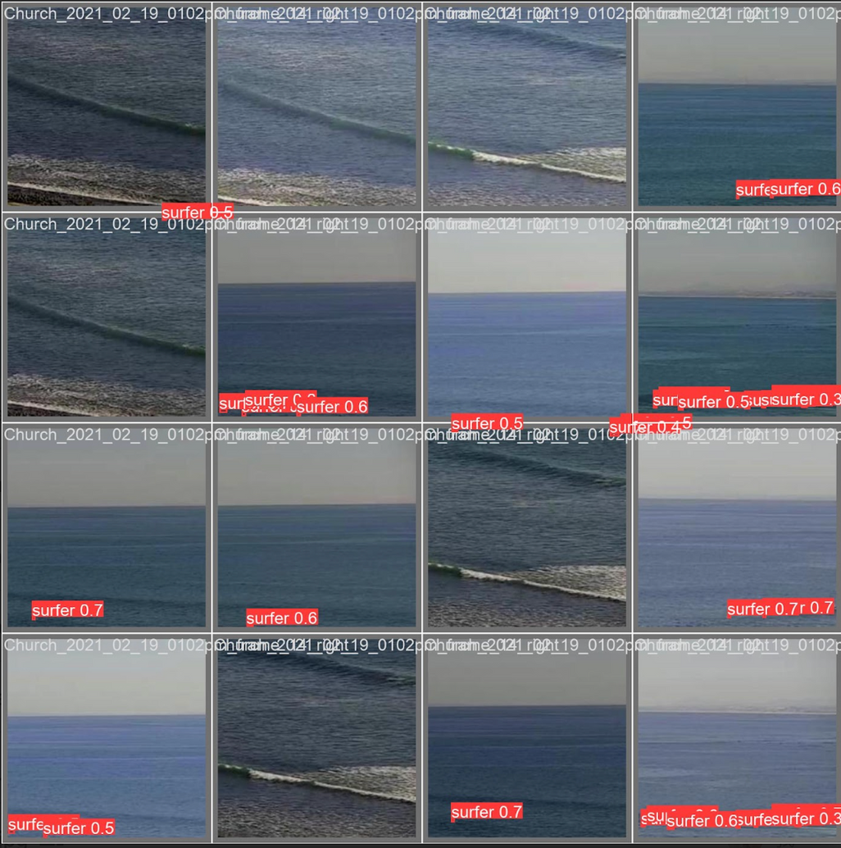

RESULTS
On - Wave detector
General detector
Notes:
After training on 20 epochs we got results. The red label above each box shows the predicted class ("surfer") and the confidence value. We can see that the On-Wave detector has higher confidence scores than the General detector. Which makes sense, because on-wave surfers are closer and clearer, so the model can detect them more easily.

Slide 18
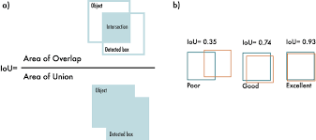
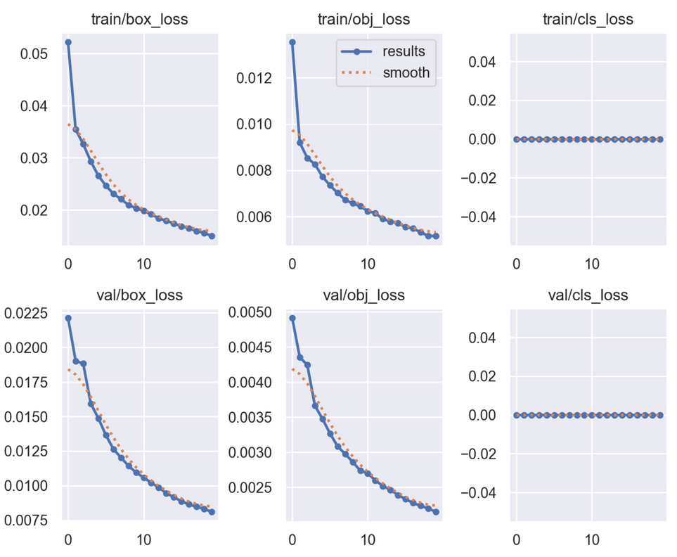
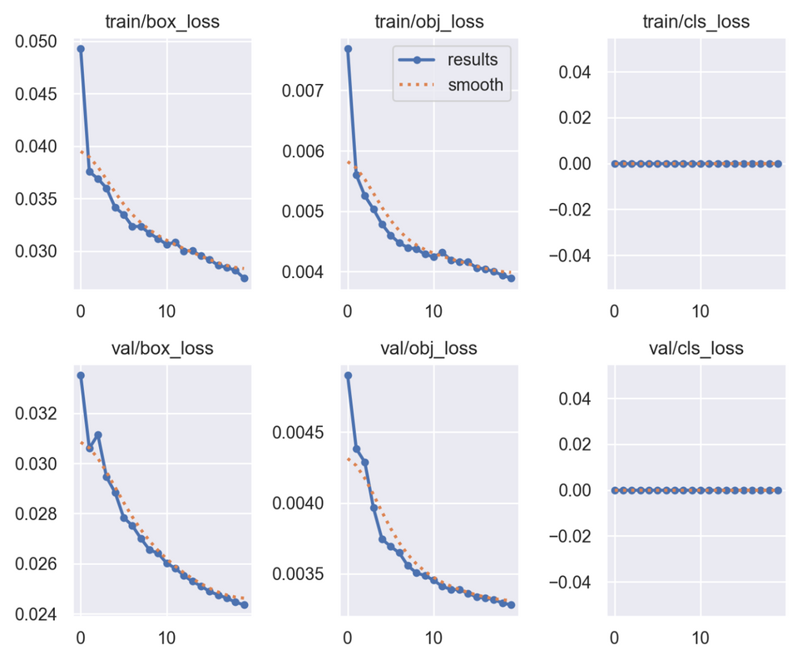
YOLOV5 LOSS FUNCTION
On - Wave detector
General detector
Notes:
YOLOv5 returns three loss outputs: the classes of the detected objects, their bounding boxes and the object scores. It uses BCE (Binary Cross Entropy) to compute the classes loss and the object loss.
While CIoU (Complete Intersection over Union) loss to compute the location loss. where the Prediction, and ground truth, overlap
Overall, our model on both data sets learns to predict better bounding boxes over time and better at distinguishing objects from the background. The cls_loss is 0 because there's just a single-class.

Slide 19
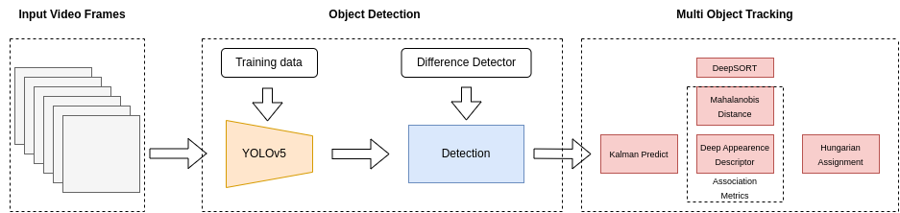
YOLOV5 WITH DEEPSORT
Challenges:
Only five surfers were showing up with bounding boxes
Not accurately tracking all the surfers
Notes:
We wanted to test the YOLOv5 model for real time video footage. YoloV5 is used to detect objects in each frame, and then we used the DeepSORT algorithm to track these objects across multiple frames and associate them with unique IDs.
Challenges/several iterations:
Needed to adjust confidence threshold from .4 to .2. We noticed only a few surfers were being picked up in the video but it is because their confidence scores were lower than the threshold.
Play around with Intersection over union threshold.
Not as accurate, far away.
Stands for: Simple Online and Realtime Tracking with a Deep Association Metric.

Slide 20
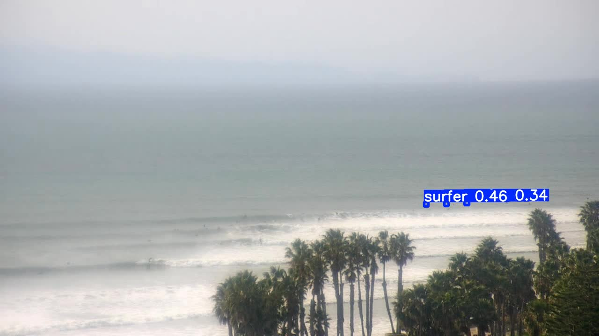
VIDEO RESULTS
Used best.pt (best weights from general detection dataset 1.1)
Used DeepSORT
Challenges
Not that accurate
Notes:
This is the test video using the general dataset model and combined with DeepSORT for tracking.
As you can see, it does detect surfers, but the confidence is not that accurate.

Slide 21

TAKEAWAYS AND LIMITIONS
Scalability:
→ Once trained, it can be used on any video, including real surfing footage.
Training Time Was Extremely Long：
→ Training and testing took a lot of time when image resolution was high.
One-Class Detection:
→ We only trained the model to detect “surfer” (class 0), so other important objects (like boards, waves) were ignored.
Notes:
Here is our key takeaways.
which is our model has good scalability. Once trained, it can be used on any video, including real surfing footage.
But there were also some challenges.
One was training time. When we used high-resolution images, both training and testing became very slow.
Another limitation was one-class detection.
We only trained the model to detect class 0, which is 'surfer'. So things like surfboards or waves were not labeled or learned by the model.
So, in the future, we need to improve in speed, class variety, and hardware optimization."

Slide 22
THANK YOU!
Questions?

